Slide 1

Baruch Data Science Challenge 2023

Slide 2


Meet your Team
David Messineo Manager US Data Science Team LinkedIn: davidmessineo
Christian Bernards Data Science Lead US Data Science Team LinkedIn: christianbernards
Shivayogi Biradar Data Scientist US Data Science Team LinkedIn: shivayogi-biradar

Slide 3
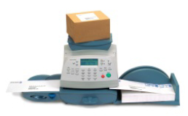
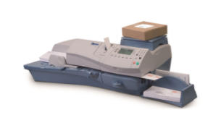
Background
Pitney Bowes is one of the leaders in the Mailing meters space
Mailing meters allow businesses to be more productive by simplifying their mailing and shipping
We offer leased hardware, as-well as SaaS solutions
Our clients must be able to rely on our meters to function to meet their customers’ needs

Slide 4
Problem Statement
Pitney Bowes has high scale shipping enterprises who do business with us.
We often observe irregular shipping throughput for a lot of our enterprise clients and it often helps us to forecast quarterly/half yearly forecasts for these clients in order to better understand their needs.
To better understand our clients needs we need to understand our clients seasonalities, client segments and their throughput behaviour

Slide 5
Solution Requirements
The following files are provided for you to use:
train.csv – Sample data containing monthly throughputs of various deidentified clients till June 2022
test.csv – generate either monthly throughput or aggregated throughput for next 6 months from cut off date
A csv file with forecast for next 6 months and/or link to your dashboards/vizualizations/insights etc
Python notebook with code and sufficient documentation
Single page poster summarizing work done and techniques implemented which will be used for presentation on the final day.
5 minute video presenting the work done

Slide 6

Judging Criteria
Business Understanding (5%)
Lean Canvas Role/Persona Definition & Interaction Recommended Enhancements
Data Understanding (10%)
Data Dictionary: meaning/influence on product Data Quality Checks: outliers, missing data, etc…
Data Polarity: relationships among fields
Data Visualization/Insights (60%)
Curated Insights of cusomers/portfolio of clients
Business Conclusions
Business Recommendations
Client Seasonalities
Model Insights
Time Series Modelling /Segmentation or Clustering (25%)
Feature Engineering & Rationale
Model Selections & Finale Rationale
Accuracy of Model Forecasts

Slide 7
Understanding CRISP-DM
Business Understanding
Data Understanding
Data Preparation
Modelling
Evaluation
Deployment

Slide 8
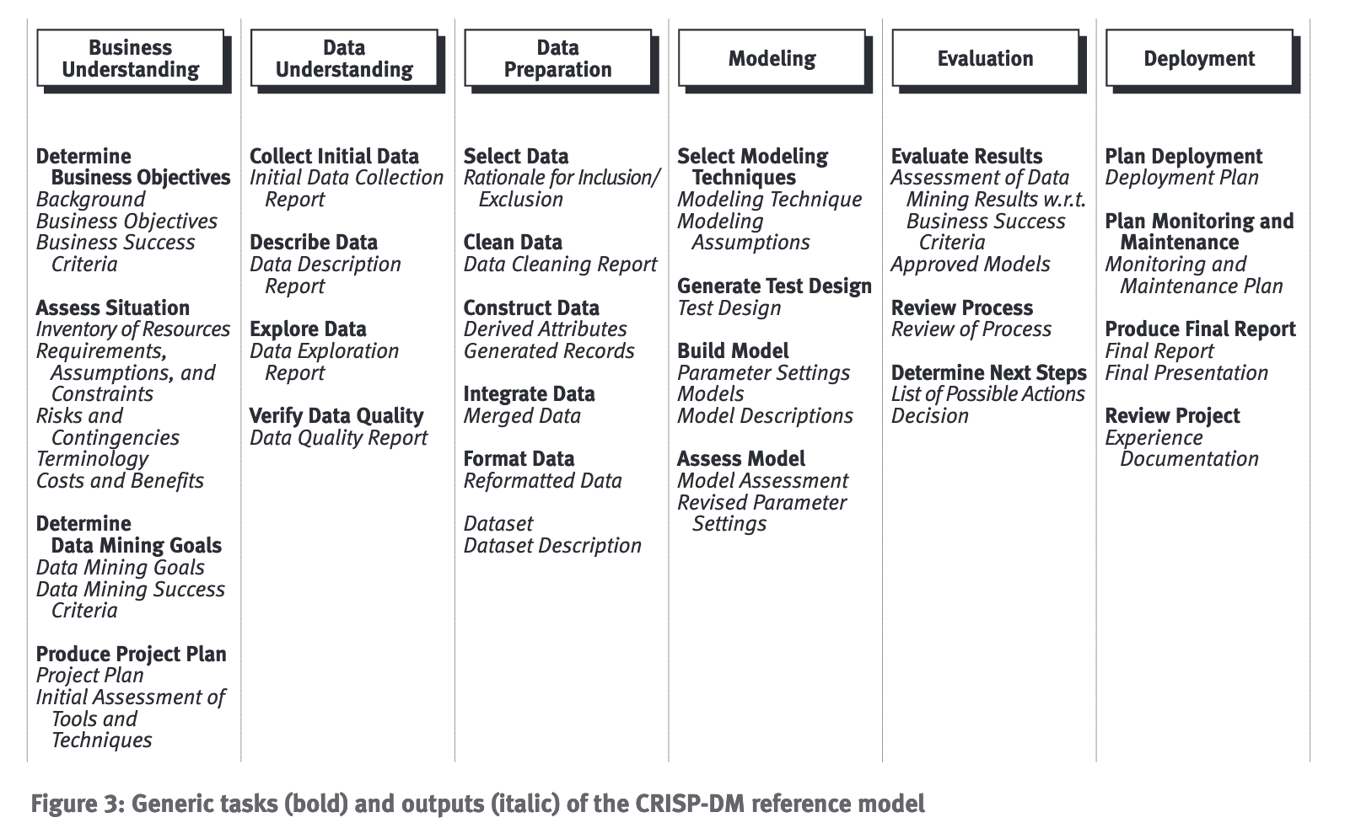

Slide 9
Resources
JupyterHub Tutorial: https://www.dataquest.io/blog/jupyter-notebook-tutorial/ https://www.anaconda.com/products/individual
Google Collab https://www.tutorialspoint.com/google_colab/index.htm
GitHub https://docs.github.com/en/github/creating-cloning-and-archiving-repositories/cloning-a-repository
CRISP-DM Specification https://the-modeling-agency.com/crisp-dm.pdf

Slide 10
Demo

